Slide 1

Full-stack Development
Week 2 – Server Routes

Slide 2

Last Week
Using the terminal
Server-side programming
Node.js
Custom API endpoint

Slide 3
This Week
Routing in depth and developing our API
HTTP Post requests
Saving to a Database

Slide 4
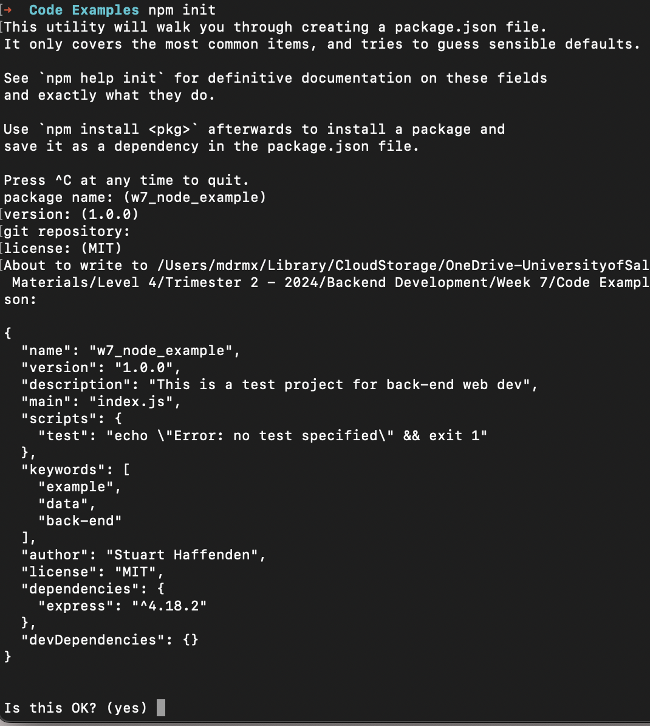
package.json
The package.json file is a configuration file, where all the metadata of our project is set up.
This includes: the packages we are using, the project name, description, authors and copyright licensing.
The npm lets us easily create a package.json file using the npm init command.

Slide 5
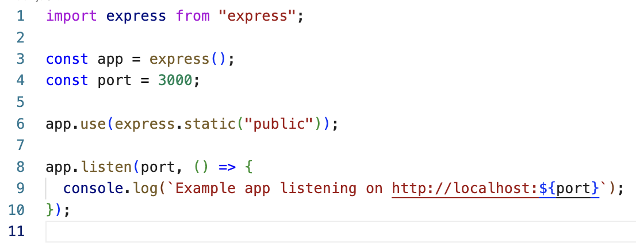
Serving a Web Page
To serve a web page from our server we need to provide an index.html file, such as the one we wrote last week.
We can provide an html file by using two functions:
First we call .use() on our app variable and pass express.static() to the use() function
express.static() passes static files to our application. Static files are files that clients download as they are from the server.
To pass a collection of files to the client side, we can create a ‘public’ folder which contains our static files, such as index.html and any data associated with it.

Slide 6
Routing and Building an API endpoint
In our code from last week, we used the Geolocation API to register our user’s location.
We created a mechanism to get the data using the Geolocation API and sent it back to our server.

Slide 7
Our Project so far
Index.html + public folder
Geolocation API
client
server
API get route

Slide 8
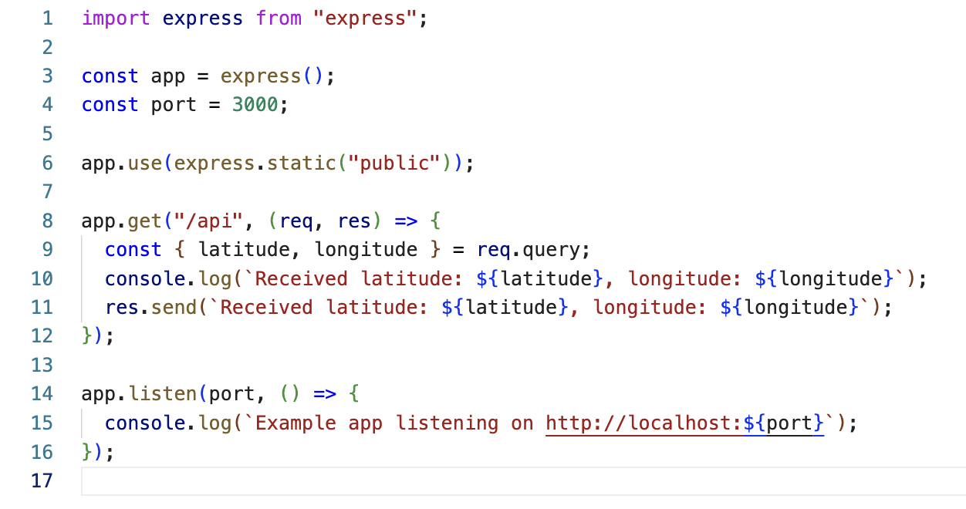
Creating our own API
In order to communicate with our express server we need to create an API endpoint. We can do this using the get() route in express.
Get() takes two arguments:
a string that defines the API endpoint
An anonymous function with two parameters: req and res
The req parameter listens out for data added as a query to the fetch request we create.
We can then use the res variable to send a response back from the server which contains some data.

Slide 9
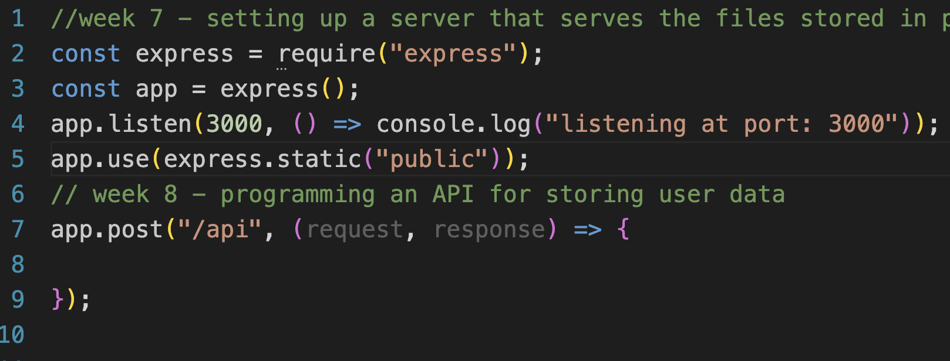
Routes
Routes are how data gets sent to and from the server and the client.
A route can either be used for getting (get request) data from the server or posting (post request) some new data to the server.
If we want to capture data from our user, we will need to create a post route.
Post
Route
https://expressjs.com/en/guide/routing.html

Slide 10
Get Route expanded
We created a simple get() route last week. It doesn’t actually get anything yet.
Our route’s only functionality is to confirm the data from the client has been received, and sending it back out to the client as acknowledgement.
In real terms, the response from our get() route will be a whole set of new data.

Slide 11
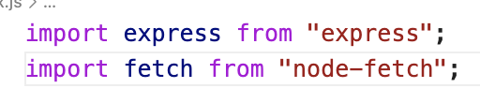
Get Route expanded
We will now make our API endpoint make a fetch request for some new data for our user.
To do that we need to install node-fetch via npm:
npm install node-fetch
This now exposes the fetch API to node. We can then import the fetch library using an import statement.

Slide 12
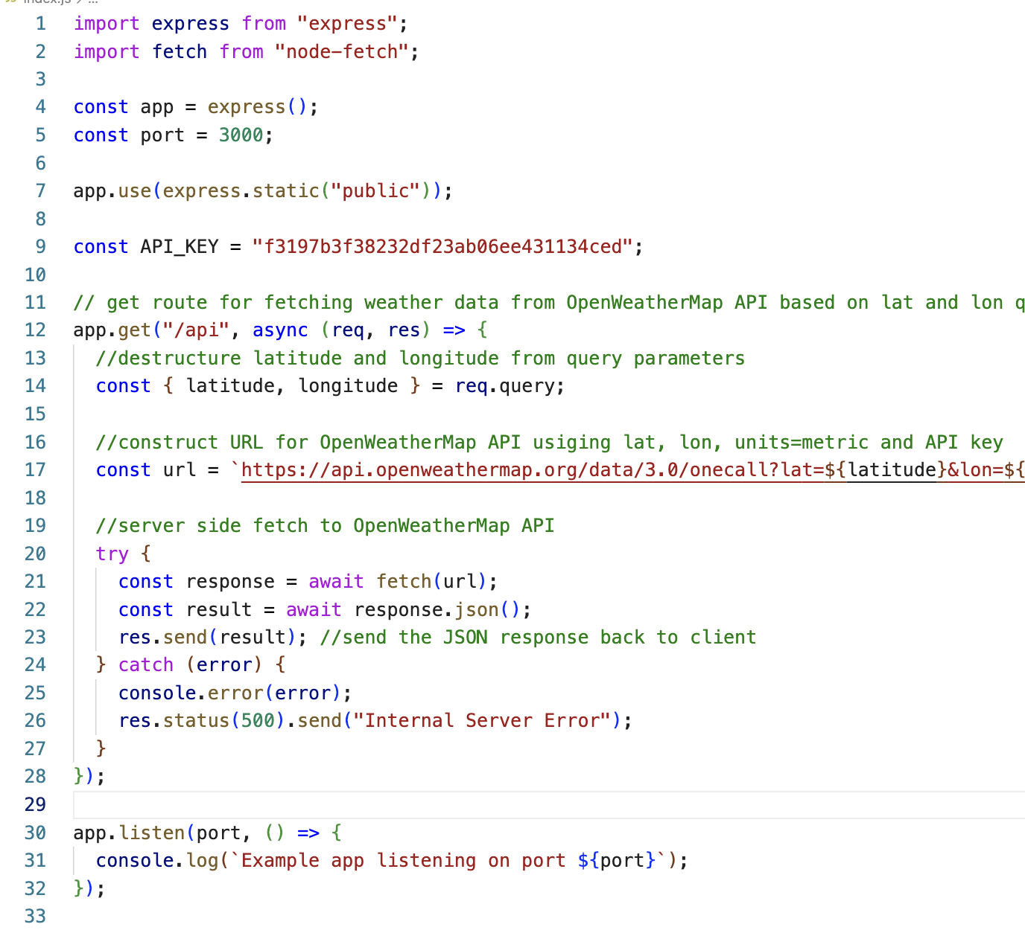
Using node-fetch
Once we import node-fetch we can follow the pattern we learnt last year.
First we need an API to fetch data from and an API key to authenticate the user.
Then we construct a URL to fetch data from using our latitude and longitude data and our API_KEY.
We then call fetch, parse the response into JSON and send it back to the user using res.send()

Slide 13
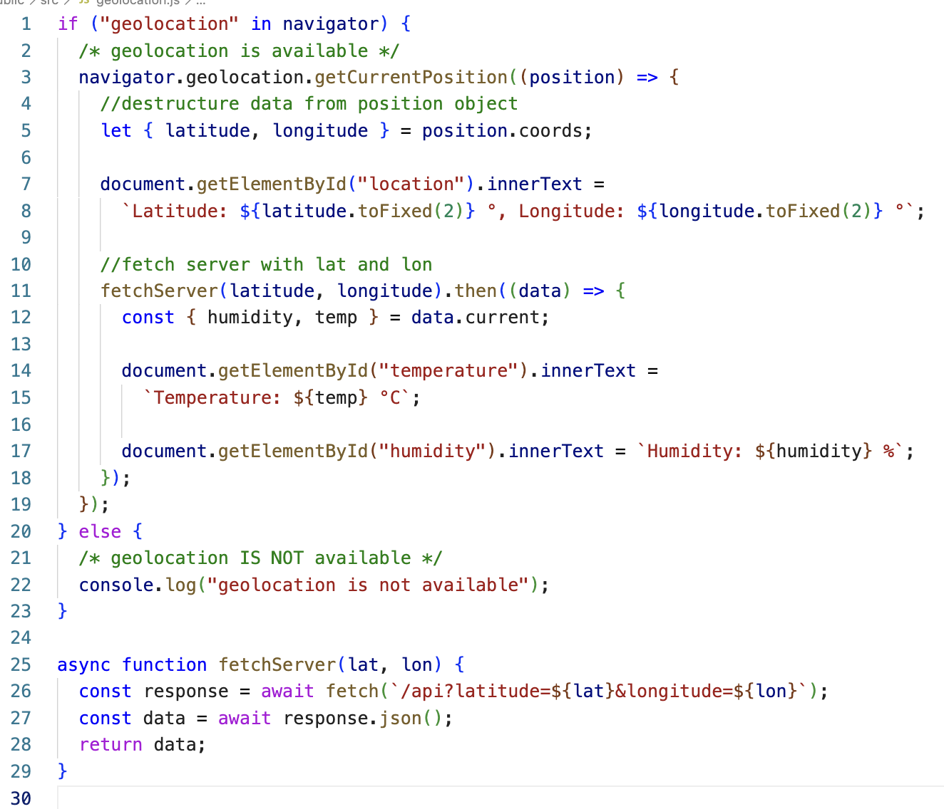
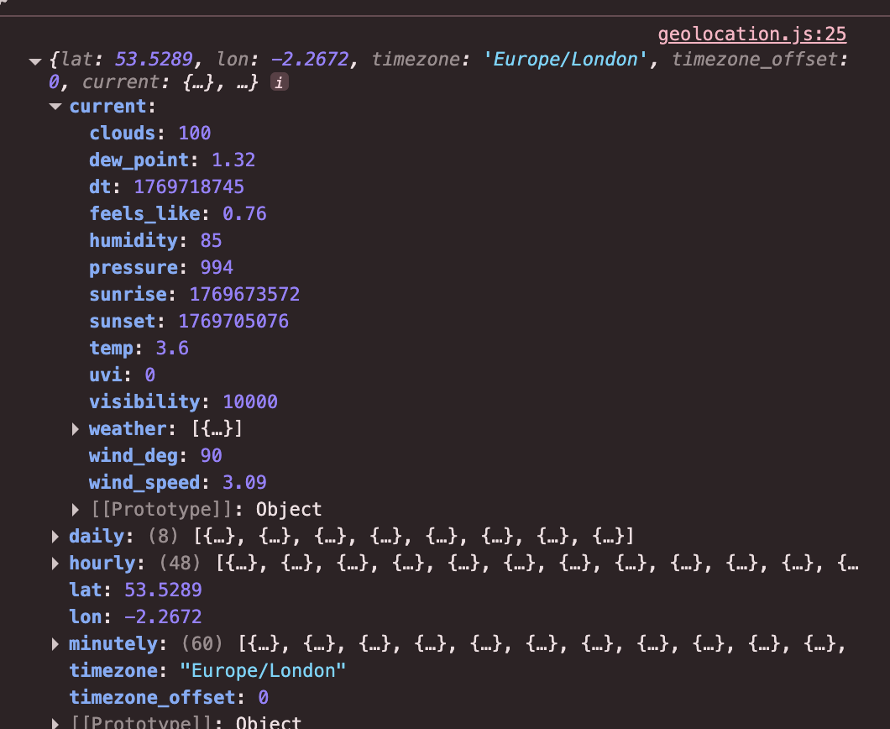
On the Client Side
On the client side we don’t have to do much.
We already have a function to fetch data from our server.
We now need to extract the data from the object our server fetched for us and insert it into the html

Slide 14
Worth noting
We have now made our page much more secure.
In the past we were writing our API requests from the front end and our API key was publicly viewable.
Now, our server contains our API key which means users cannot use it to their benefit.
But there is one more step to make this even more secure.

Slide 15
dotEnv
Dotenv is a zero-dependency module that loads environment variables from a .env file into process.env.
Storing server configuration settings in the environment separate from code is based on The Twelve-Factor App methodology which is a framework for building more secure apps.
To install dotenv: npm install dotenv

Slide 16
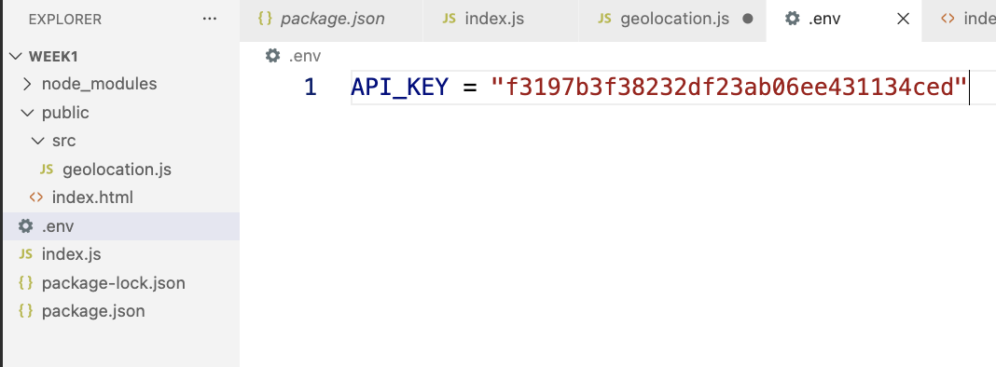
Create and use environment variables
You must then create a file called .env and inside it we can save our API key as follows

Slide 17
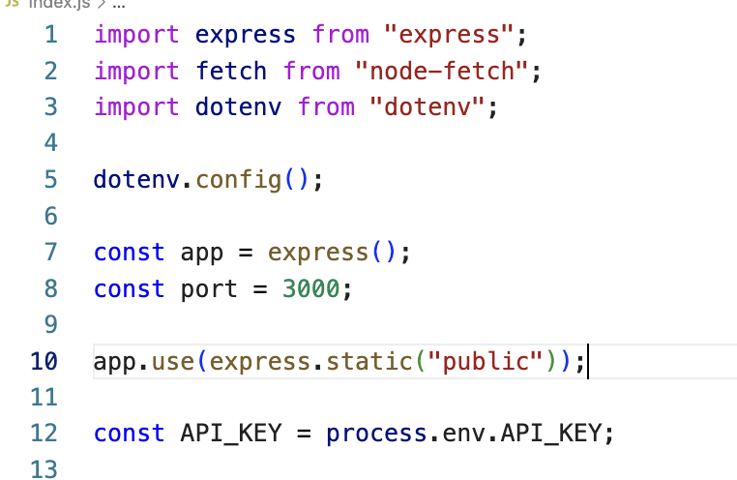
Create and use environment variables
Finally, we can import dotenv with an import statement.
We then load the environment variables into the server using dotenv.config()
And we then delete our hardcoded API key and call process.env.API_KEY to reference the key without ever exposing it directly in the server code.

